Slide 1

Case Study
Banking Marketing Analysis
- Group 5
-Yuanying Li, Ketaki Joshi, Na Qian, Chen Liang

Slide 2
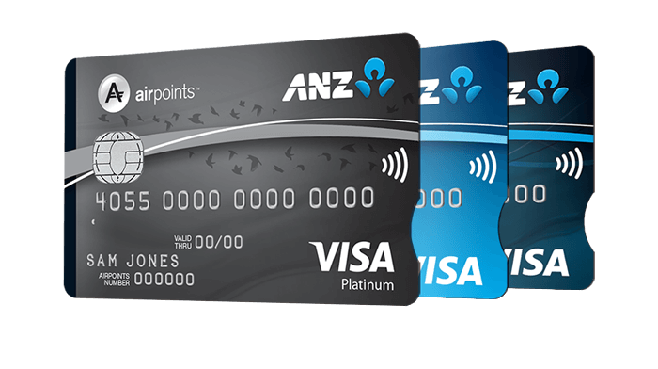
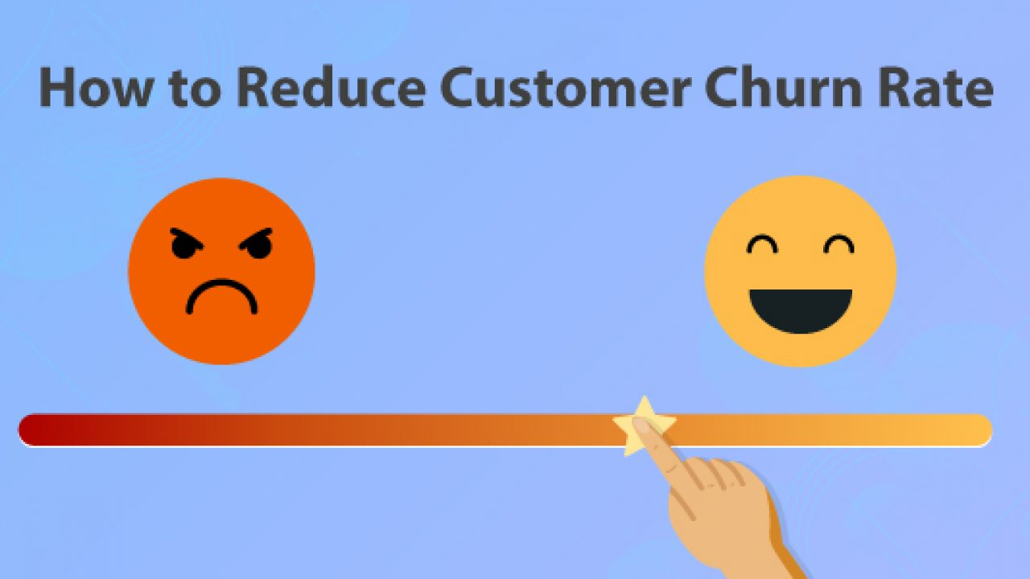
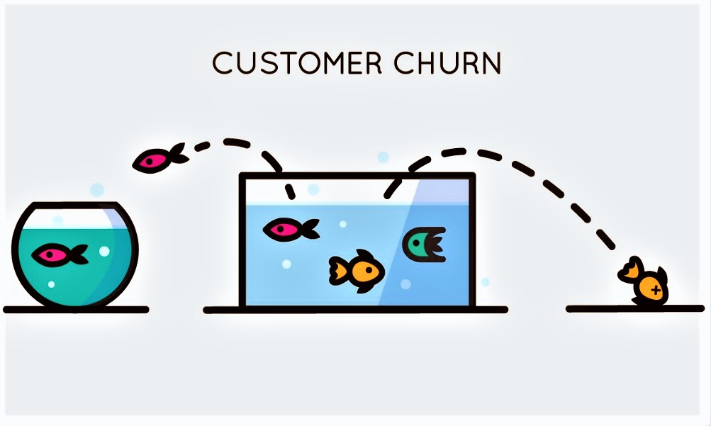
Case Study Problems Highlights
Part 1 - Credit Card Marketing
Part 2 - Customer Churn Analysis
Why do some bank customers accept credit card offers?
What are the characteristics associated with a customer who will or will not activate a credit card?
How can a bank reduce loss of customers to their competition and then reduce customer churn?

Slide 3
Part I - Credit Card Marketing

Slide 4
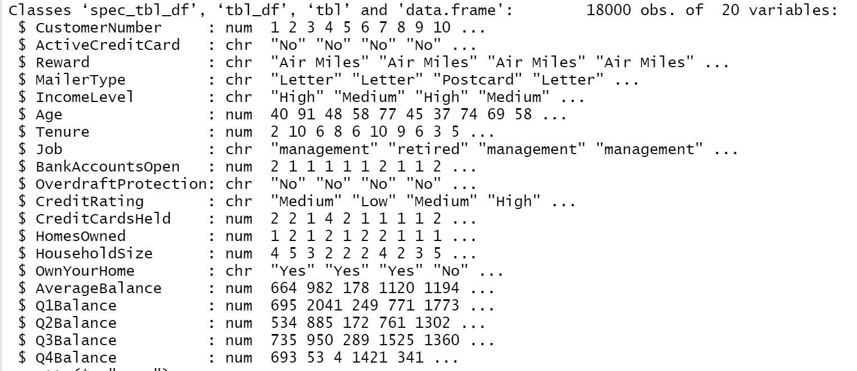
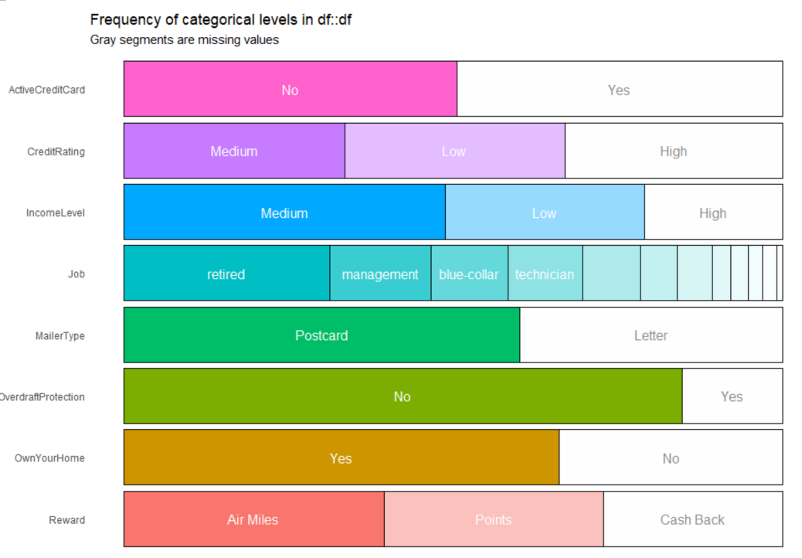
Data sets and pre-processing
Missing values are replaced by the mean
Deleted customer number, Q1-Q4 Balance
Imbalanced classes conversion

Slide 5
Key Trends
Data Visualization

Slide 6
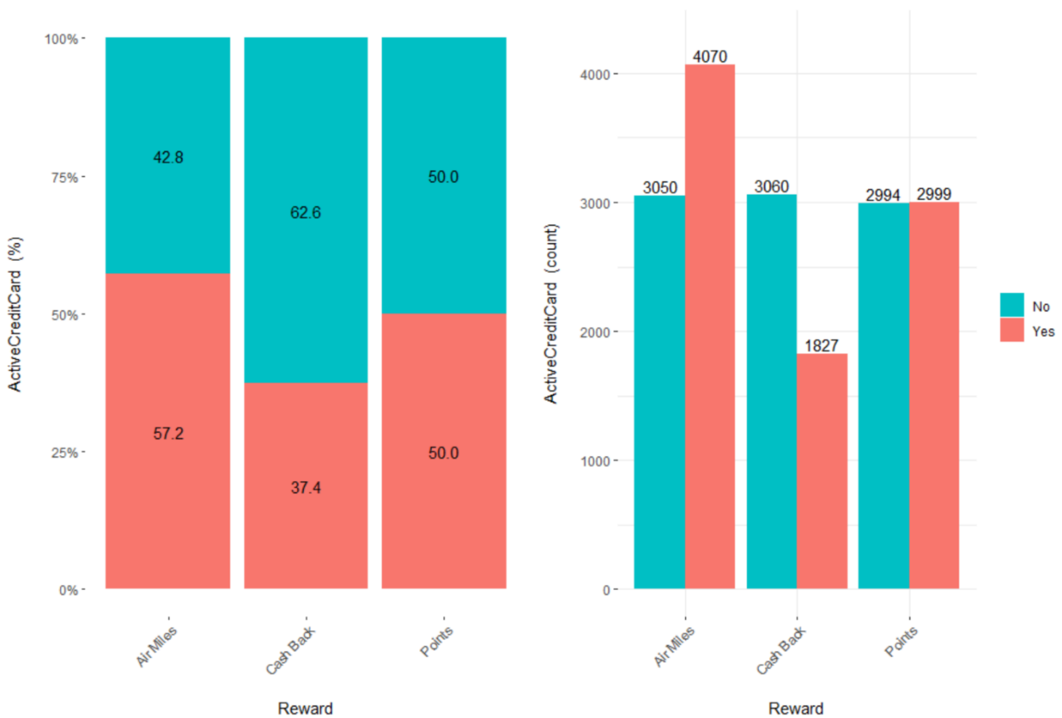
Reward vs Active credit card
The Air miles were the most attractive reward, while the CashBack reward was less preferred.
Cash Back may not be a very effective reward to attract customers, only 1827 people would accept a cashback offer, which is only 37.4%.

Slide 7
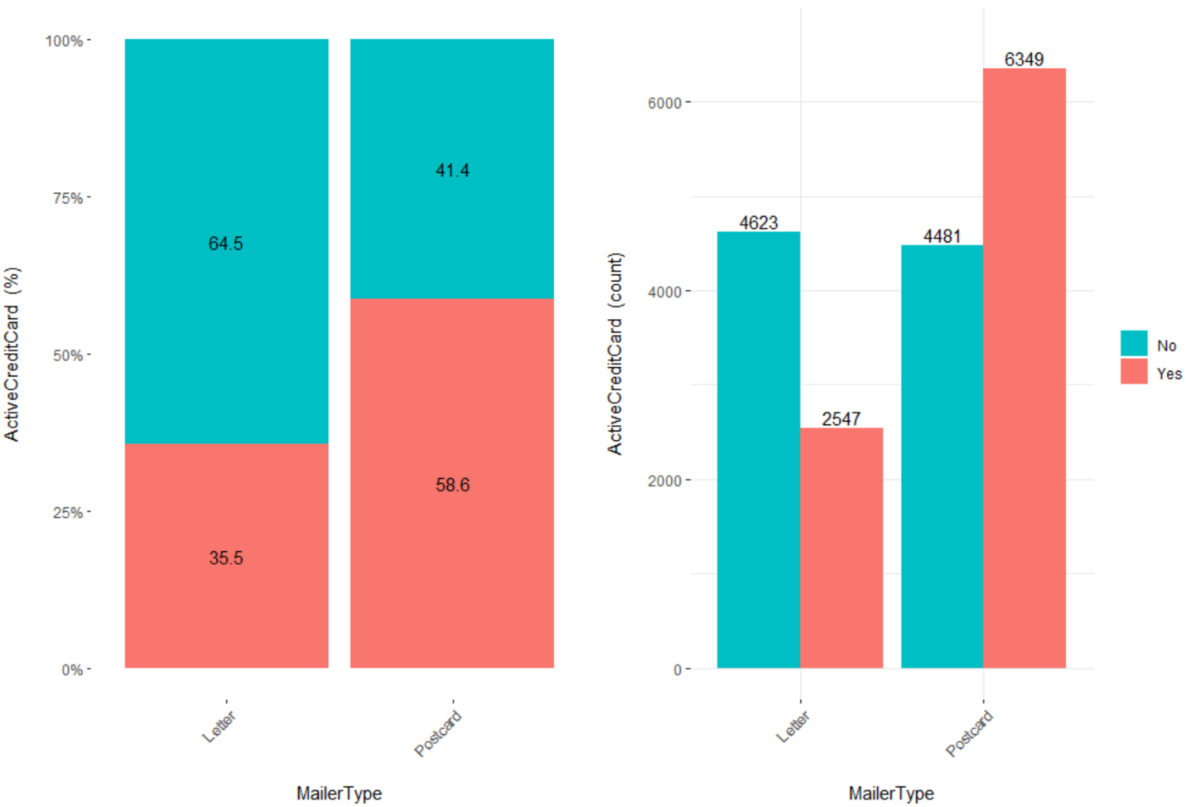
Mailer Type vs Active credit card
Comparing those two ways, individuals opted to accept an offer through the postcard.
It looks like the marketing team of the bank focused its efforts on a postcard campaign to make people accept a credit card offer.

Slide 8
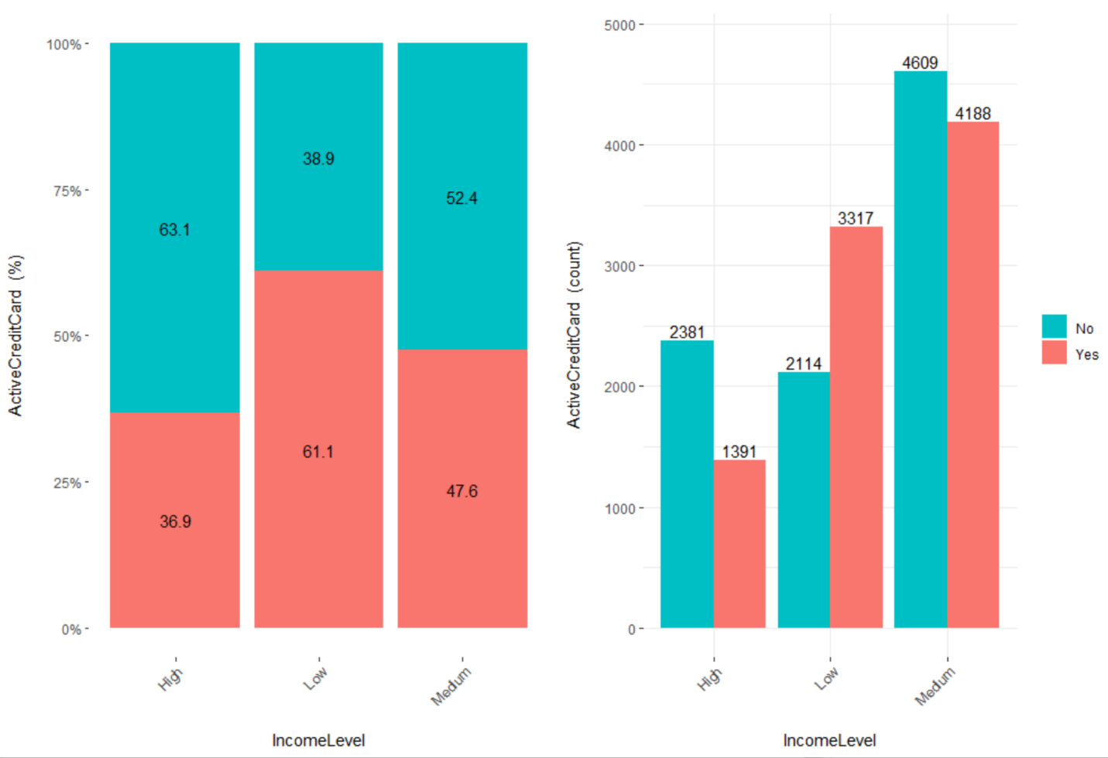
Income-level vs Active credit card
People from a low-income or medium level would most likely accept an offer since the credit card could offer them a lot of conveniences and low-income level people may not easily apply for a new credit card.

Slide 9
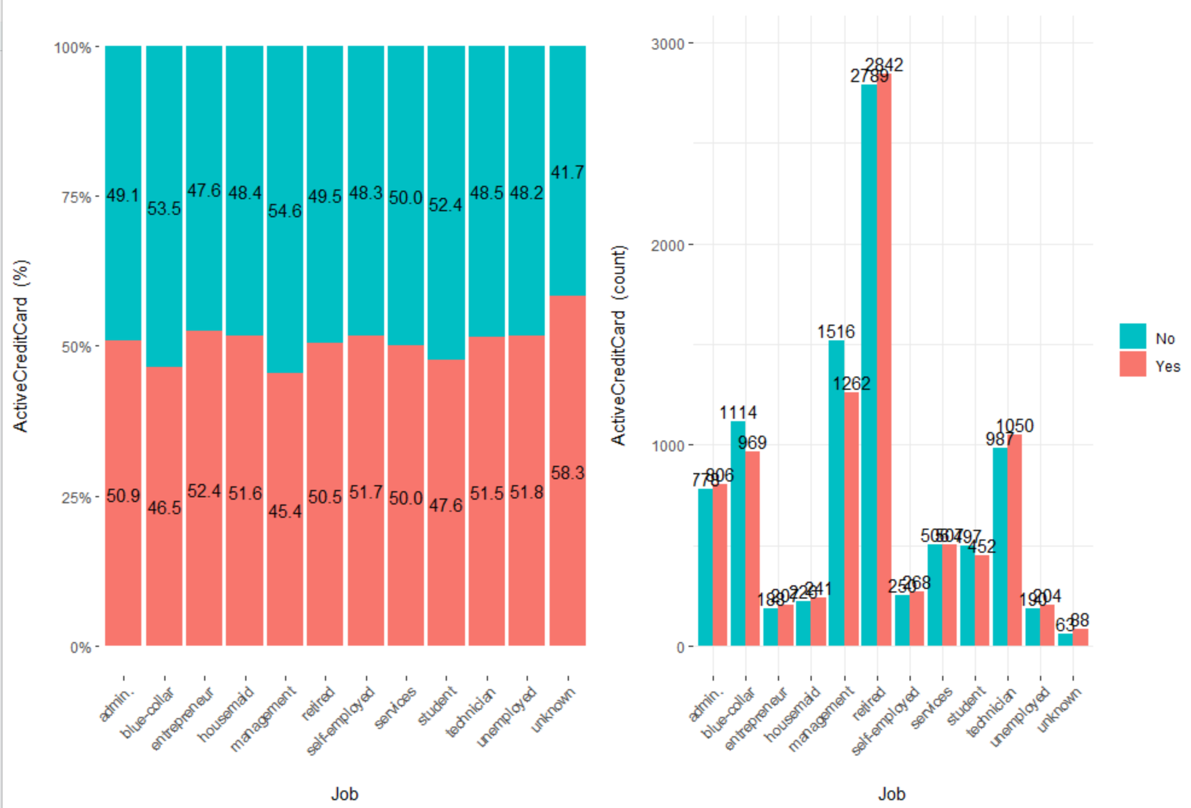
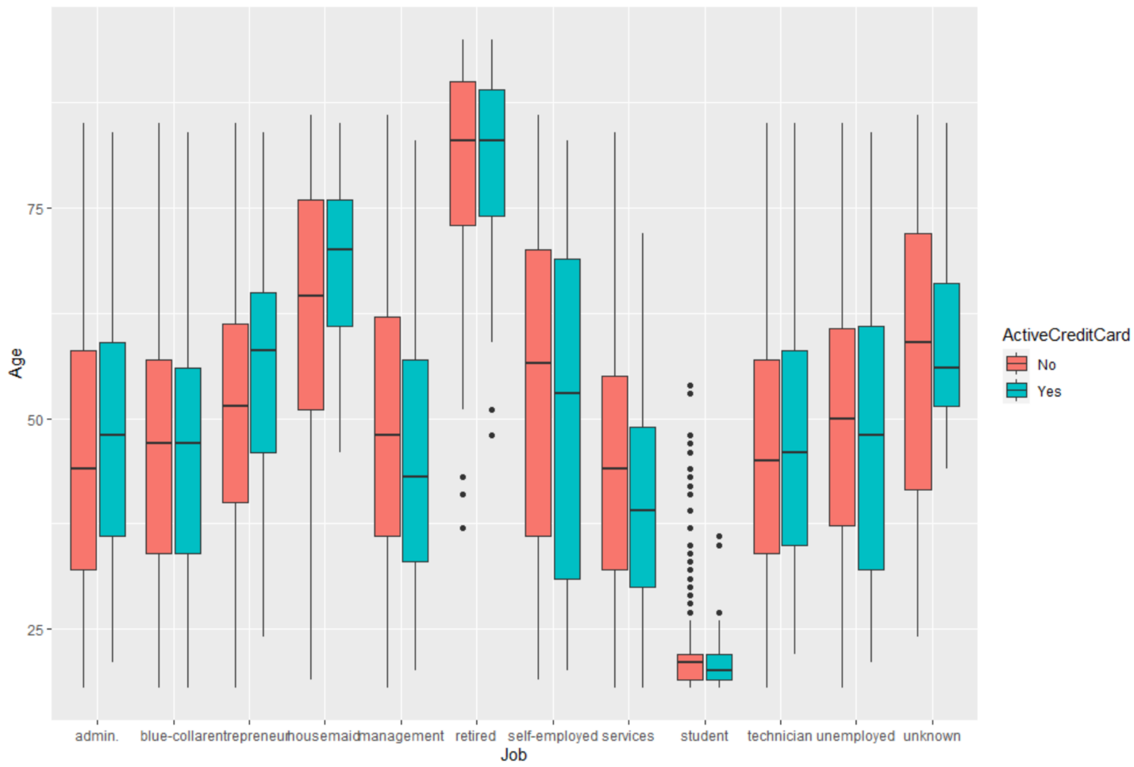
Job, Age vs Active credit card
Except for an unknown job, people who are entrepreneurs, unemployed, and self-employed are most likely to accept the offer and activate a credit card from the marketing campaigns.
In the box plot, the clients who belong to the entrepreneur category and refused to activate a credit card were much younger (median age: Around 54) than the potential clients who accepted to accept a credit card offer (median age: Around 66).

Slide 10
Applied Statistical models

Slide 11


Handling Imbalance class
The dataset contains 16977 negative cases and only 1023 positive cases.
Percentage:
Positive cases : 5.68% (rounded)
Negative cases: 94.31% (rounded)
Used undersampling and oversampling method

Slide 12
Applied Statistical models
Goal: To identify and predict which customers will accept the offer and activate a credit card and who will decline the offer.
Model:
Decision Tree
Naive Bayes
Random Forest
Reason for selecting these three models: Structure of our dataset
Model building and predictions: 75:25 ratio
Training set- Model building
Test set- Predictions

Slide 13
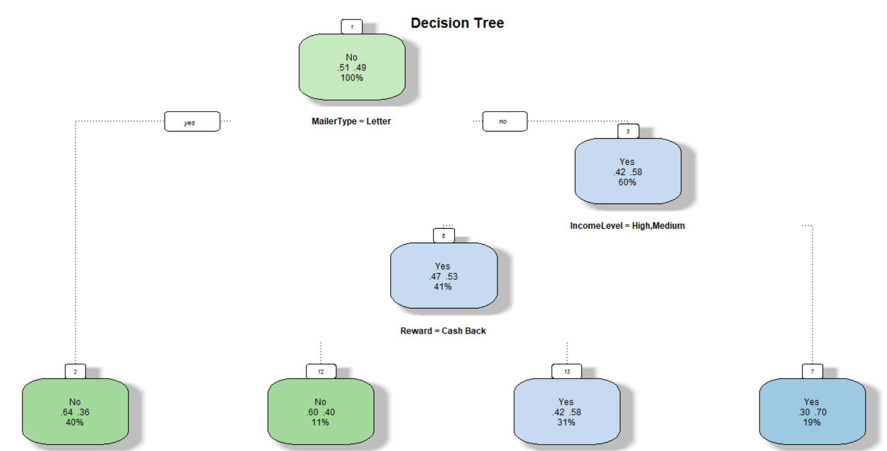
Applied Statistical models
Decision Tree
Important Variables:
MailerType
IncomeLevel
Reward
Nodes created = 13
Accuracy: 63.58%

Slide 14
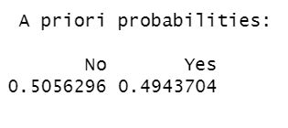
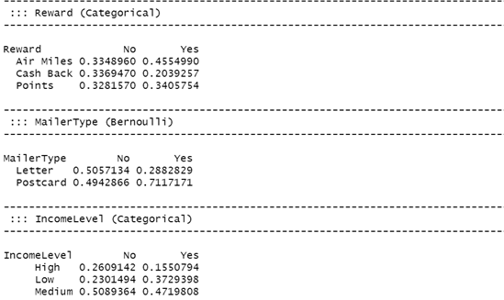
Applied Statistical models
2. Naive Bayes
Accuracy: 64.4%
50.56% points belongs to No, meaning customers will reject the offer while 49.43% of customers will accept the offer.
Preferred reward is Air Miles followed by Points.
Customers prefer Postcards over Letters.
Medium income level group have a high probability.

Slide 15
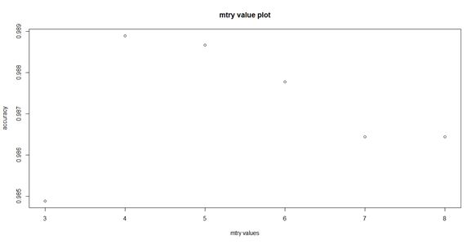
Applied Statistical models
3. Random Forest
OOB error with default parameters = 1.44%
OOB error with tuned parameters = 1.04%
Optimal parameters: ntree = 500, mtry = 4
Accuracy: 98.88%

Slide 16
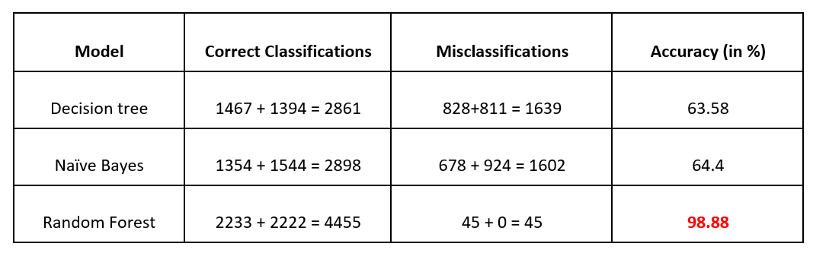
Model evaluation and comparison
Used Random Forest model with optimal parameters (mtry = 4, ntree = 500) to make predictions

Slide 17
Predictive Insights mock-up

Slide 18
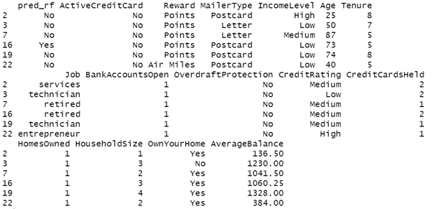

Model predicted 2233 will reject the offer and 2267 will accept the offer and activate the credit card.

Slide 19
Part II
Customer Churn Analysis

Slide 20
Data sets and pre-processing

Slide 21
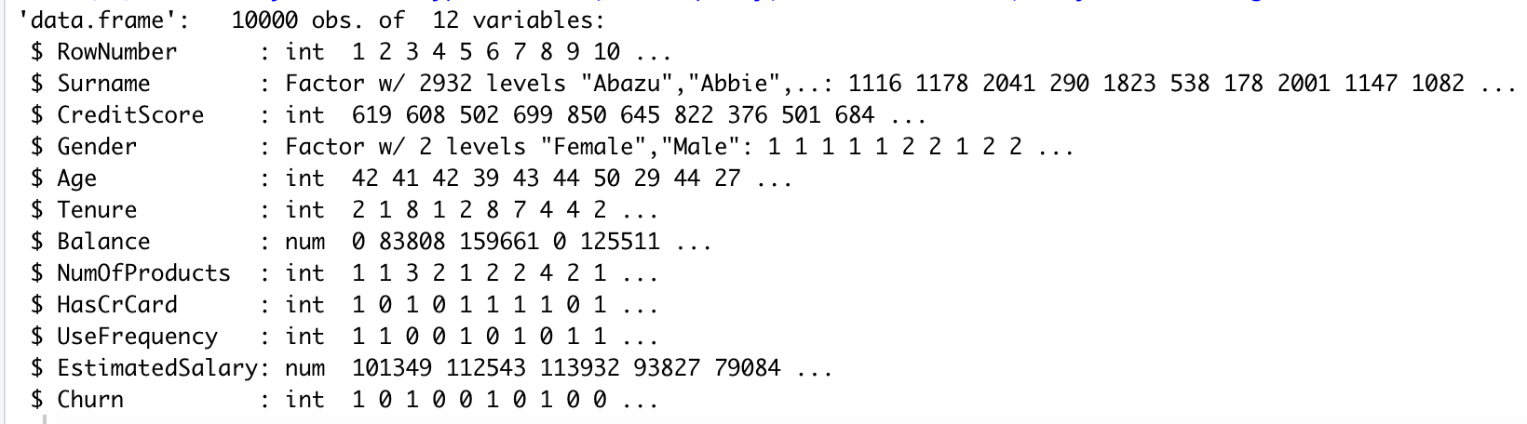
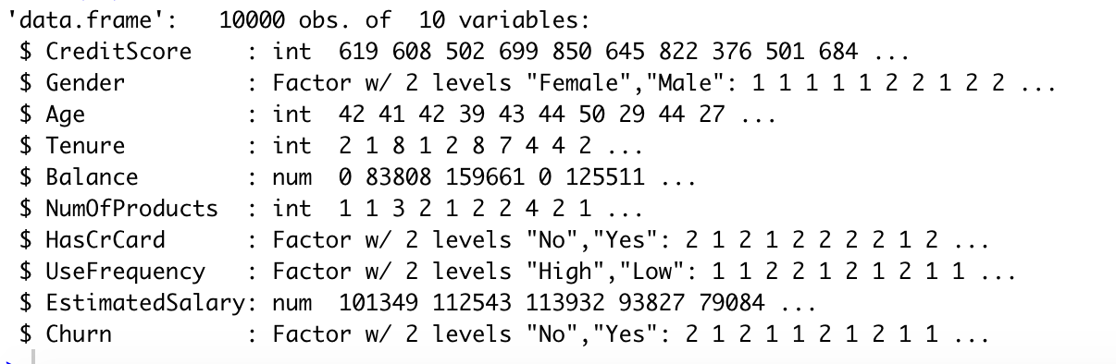
There is no null value in this dataset
Delete RowNumber and Surname
Convert the data type of HasCrCard,UseFrequency and Churn from integer to factor

Slide 22
Key Trends
Data Visualization

Slide 23
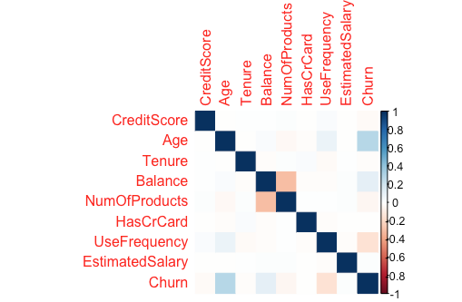
Relationships Between Variables
Churn is most correlated with
Age and UseFrequency.

Slide 24
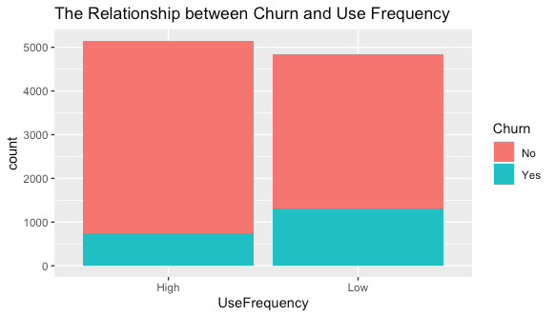
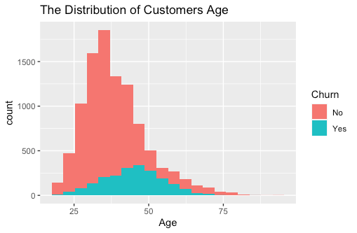
Churn VS Age | Churn VS Use Frequency

Slide 25
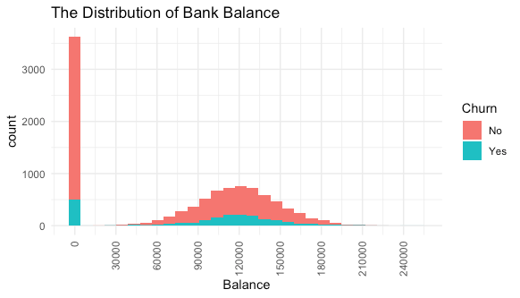
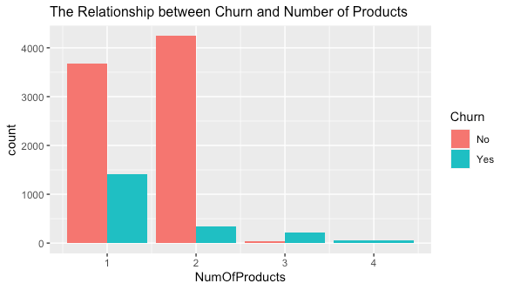
Churn VS Num of Products | Churn VS Bank Balance

Slide 26
Applied Statistical models

Slide 27
Applied Statistical models
Goal: Classify the customers who will and will not churn
Model:
Logistic Regression
KNN
Decision Tree
Random Forest
Naive Bayes

Slide 28
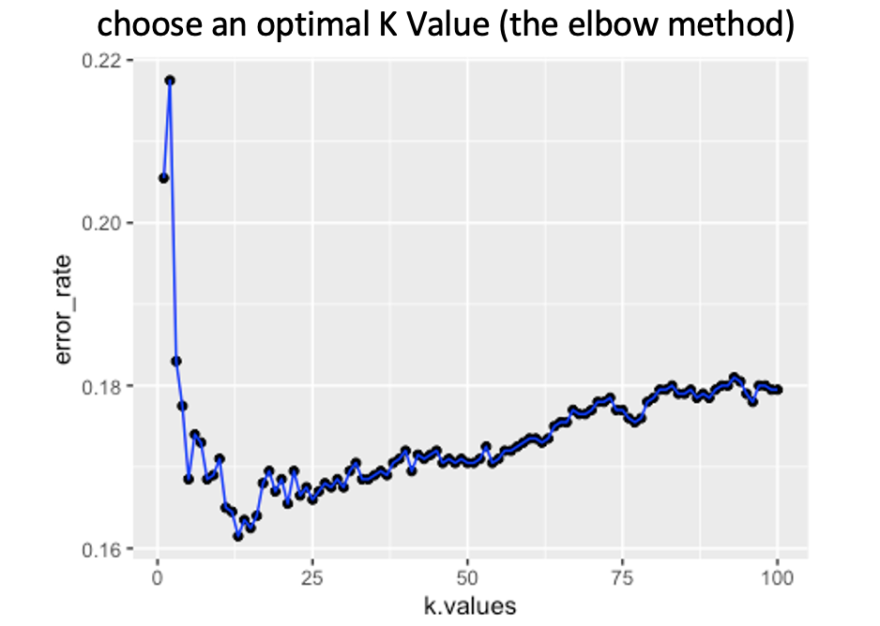
Applied Statistical models
1. Logistic Regression Model -- Accuracy: 0.8065
2. KNN model -- Accuracy: 0.8385
K=13 gave the lowest error rate

Slide 29
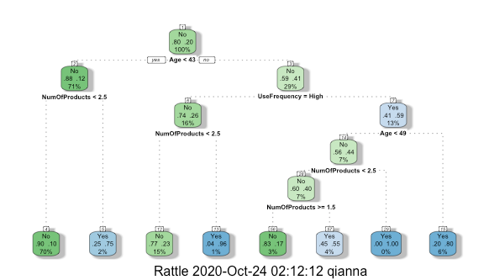
Applied Statistical models
4. Random Forest -- Accuracy:0.8538
Optimal Parameter: ntree=100, mtry=2
5. Naive Bayes -- Accuracy :0.8285
3. Decision Tree
--Accuracy: 0.8285
Model | Accuracy
Logistic Regression | 0.8065
KNN | 0.8385
Decision Tree | 0.8285
Random Forest | 0.8538
Naive Bayes | 0.8285

Slide 30
Predictive Insights mock-up

Slide 31
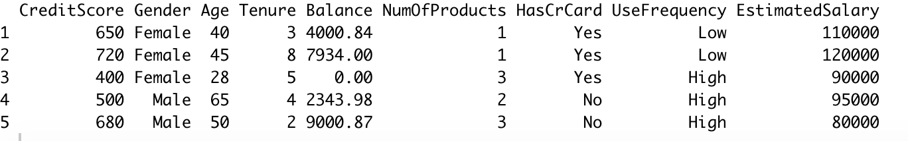
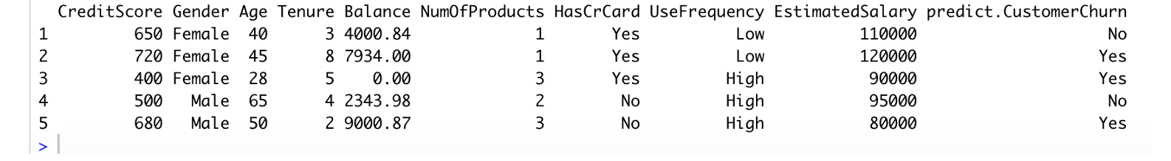
Use Random Forest with ntree=100 and mtry=2 to make predictions

Slide 32
Summary

Slide 33
Credit Card Activation
Through data analysis, we understood various aspects related to customer credit card activation.
Reward, Mailer Type, and other marketing strategies have impacts on whether the customer activates the credit card or not.
Different age, job, income level, and family size would also affect customers getting credit cards.
House ownership and balance in the bank account don’t have a strong relationship with the credit card activation.
Random Forest is the best model to predict whether a customer would activate the credit card or not.

Slide 34

Strategies to promote credit card activation
Target customers:
Age: 18-35 years old and over 58 years old
Income: Medium and Low income level
Occupation: Entrepreneurs, Self-employed professionals,and unemployed people
Tenure: Associated with our bank for five years and more
Account numbers: 1 to 2 bank accounts, 1 to 3 credit cards
Marketing strategies:
Focus on Air Miles and Points as rewards to increase credit card activation rate.
Choose postcard as a major promotional mail type which allows customers to quickly understand the company’s message.
Make a personalized offer.

Slide 35
Customer Churn
Age, use frequency, balance, and num of products have higher correlations with churn.
Most of our customers are between 30 and 45 years old. Customers whose ages are between 40 and 55 are more likely to leave the bank than younger ones.
Most customers have one or two products from the bank. Customers who have more than two products are more likely to churn.
Random Forest is the best model to predict whether the customer will stay or not.
Around 8000 people did not churn in our dataset. We will target those people based on our analysis and utilize marketing strategies.

Slide 36


Strategies to prevent customer churn
Actively engage customers with products from emails, phone calls, and mobile news. Clarify the benefits of products and offer news updates.
Examining current products and do some surveys to find out the reasons for churn.
Offer suitable investment products to middle age customers, such as early-intervention retirement planning.
Offer low-cost, low-fee checking accounts, low-interest lending and credit products.
Develop a user-friendly platform for older customers.

Slide 37
References
1. Credit Card Marketing Classification Trees, Grayson, Gardner,2015
https://www.jmp.com/content/dam/jmp/documents/en/academic/case-study-library/case-study-library-12/analytics-cases/ct-creditcardmarketing.pdf
2. Churn for Bank Customers. Retrieved from Kaggle
https://www.kaggle.com/mathchi/churn-for-bank-customers
3. Maya Abood (January 2015). Adopting Age-Friendly Banking to Improve Financial Well-Being
for Older Adults
https://www.frbsf.org/community-development/files/Age_Friendly_Banking_Jan2015.pdf
4. Credit card dataset Retrieved from DataWorld
https://data.world/gautam2510/credit-card-dataset/workspace/data-dictionary
5. Analytics Vidhya (March 28, 2016): Practical Guide to deal with Imbalanced Classification Problems in R Retrieved from Analytics Vidhya
https://www.analyticsvidhya.com/blog/2016/03/practical-guide-deal-imbalanced-classification-problems/

Slide 38
Thank you !

